Slide 1

Jannetta Steyn

Slide 2
How it all started
SSI Collaborations Workshop 2021
Hackday winner
SSI Fellowship 2022
Running workshops without Internet access
Use Raspberry Pi as an access point and web server

Slide 3

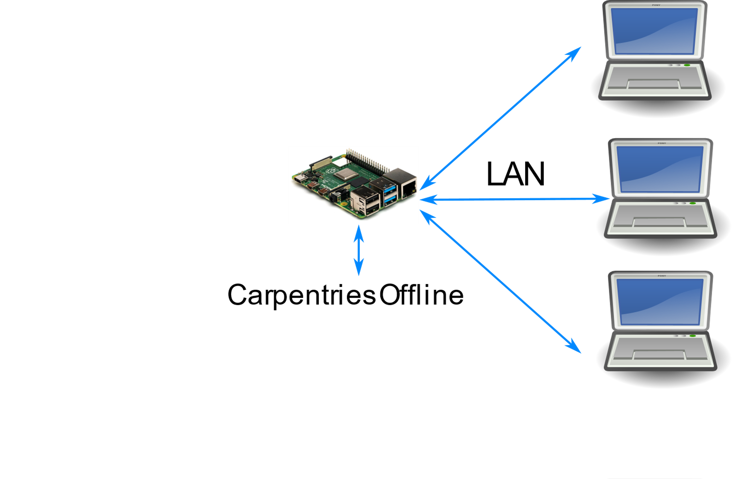
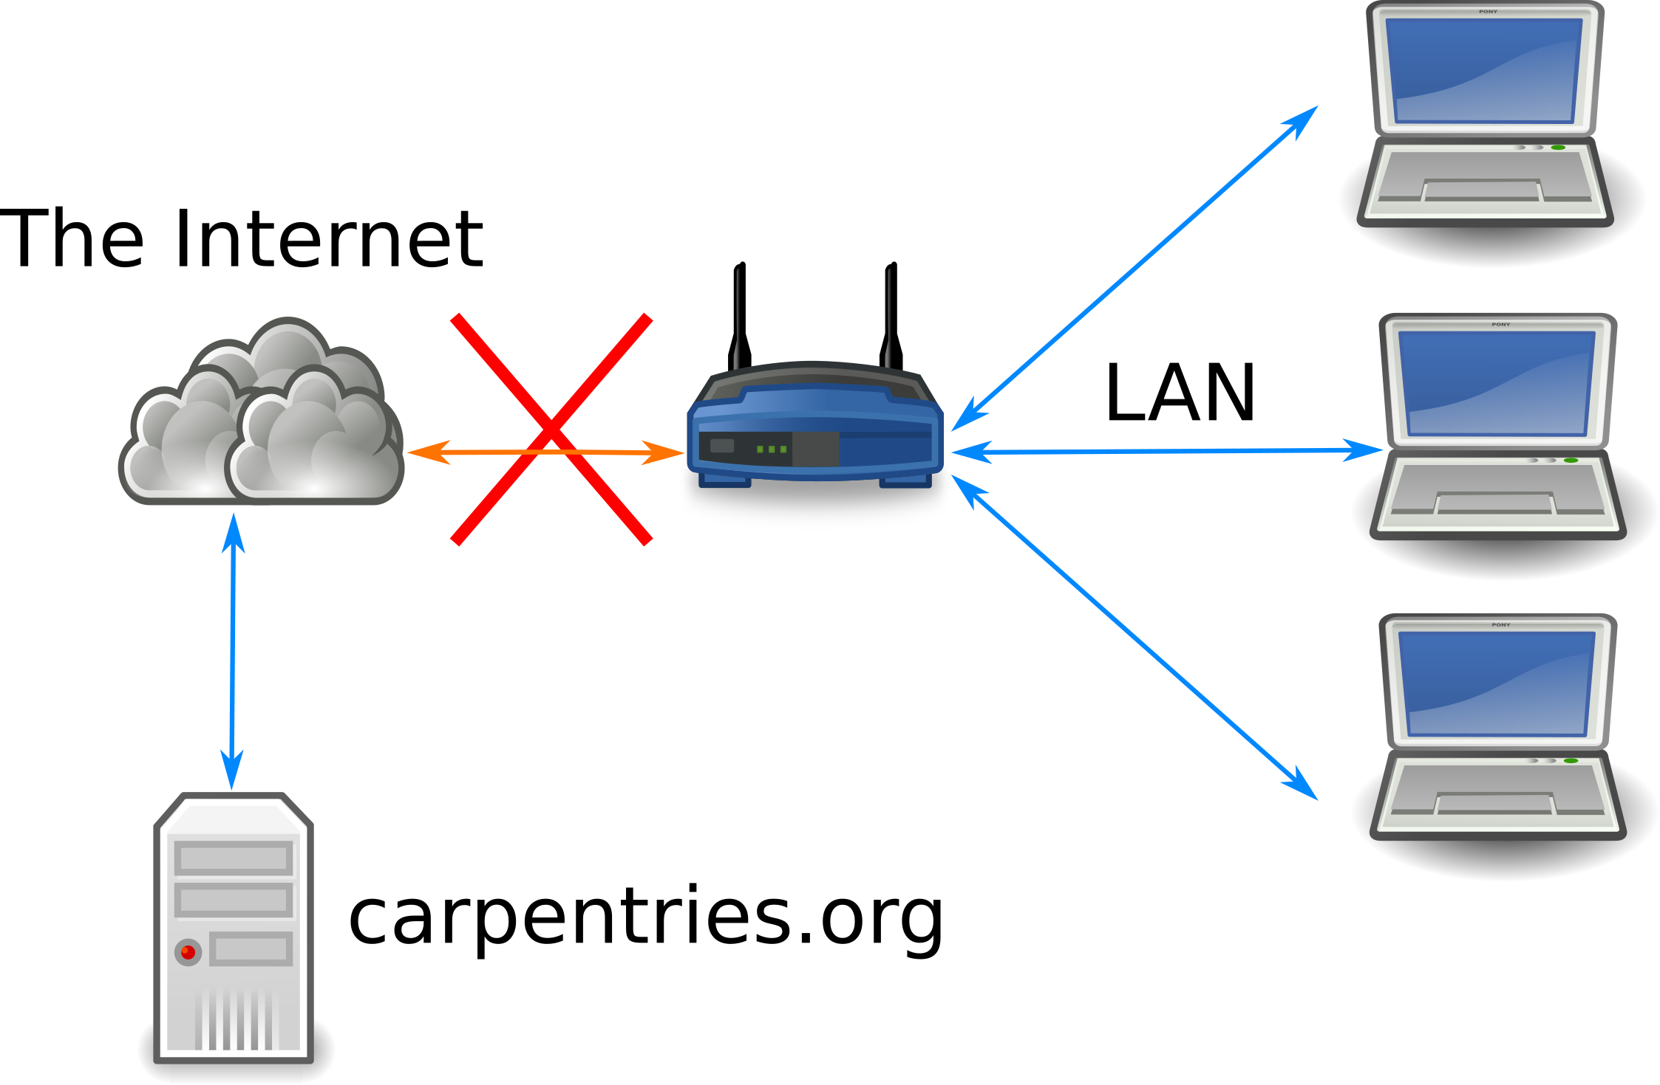
Option 1
RaspOS
Apache2
Gitea

Slide 4
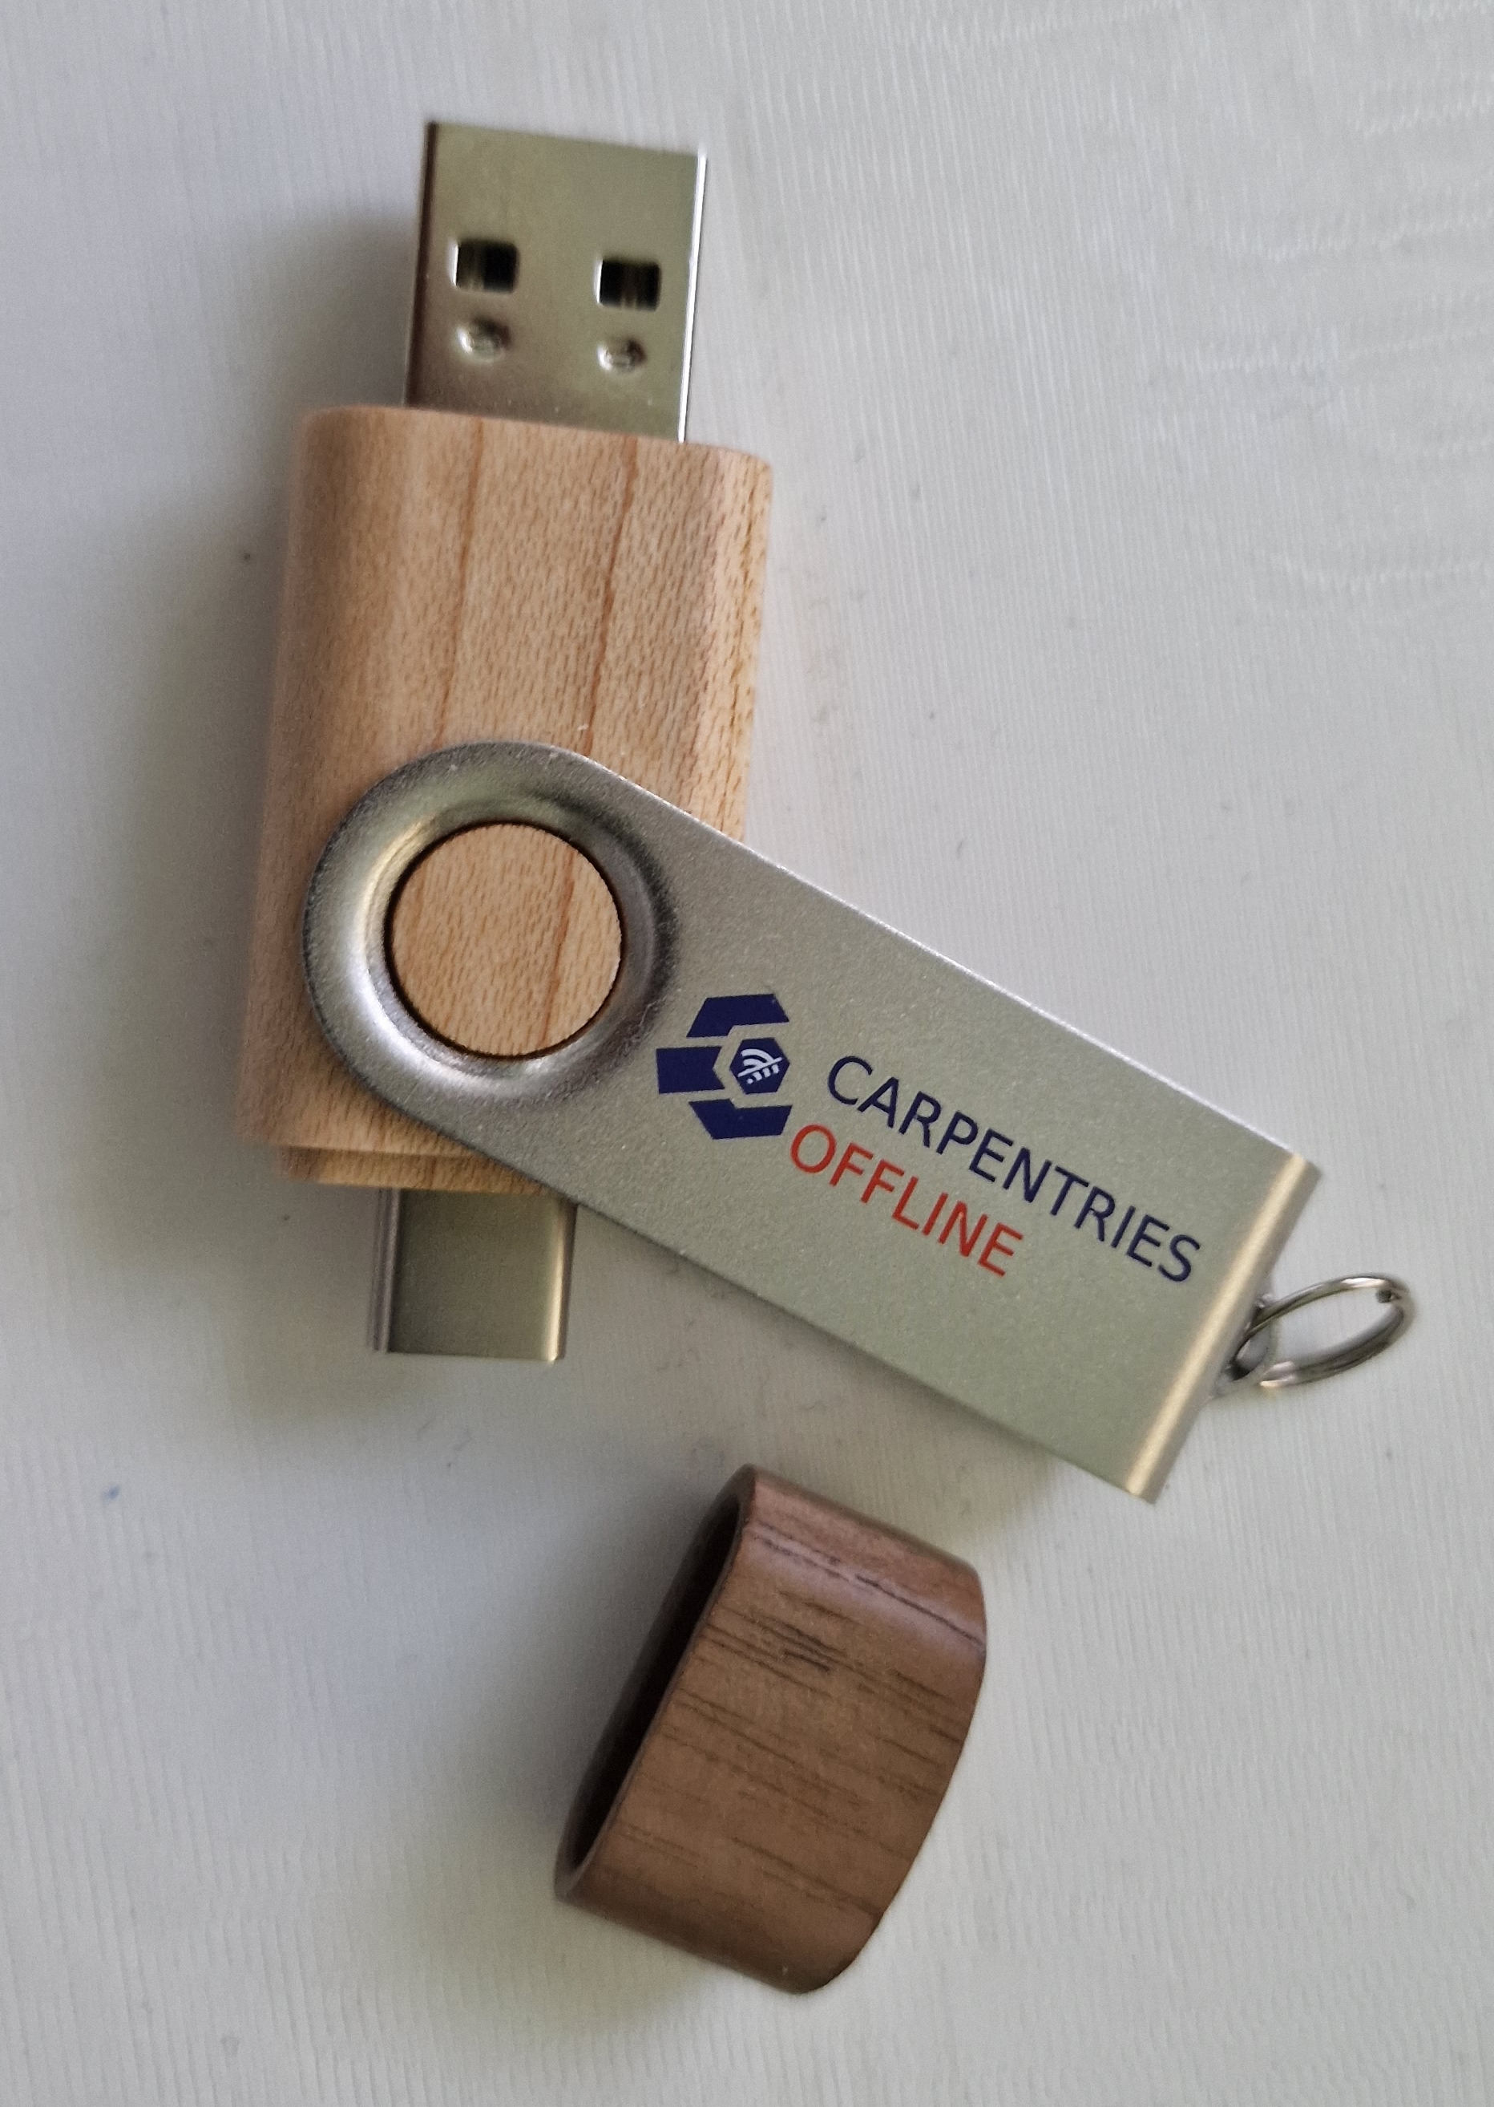
Option 2
Bootable flash drive
Slax Linux
Apache2
Gitea
OfflineDataSci – python package

Slide 5
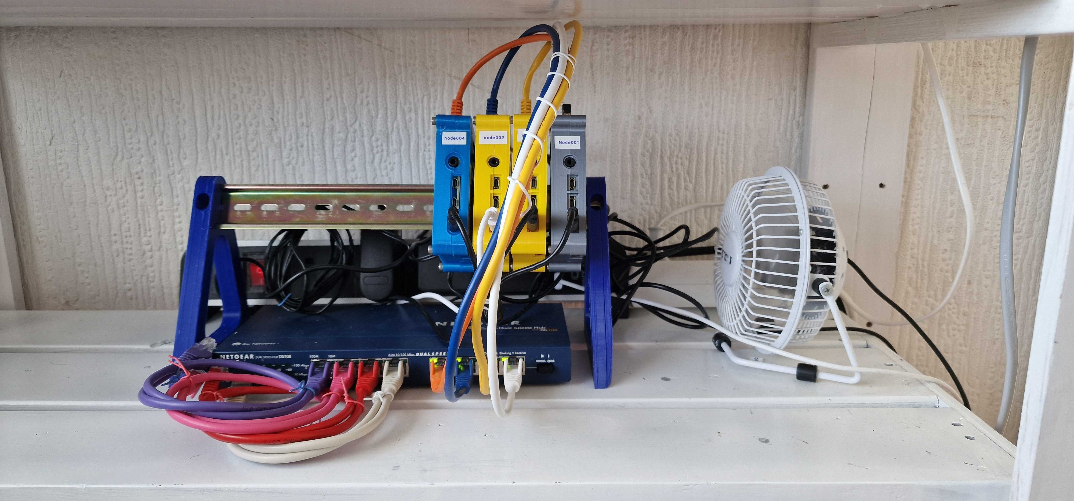
miniHPC
Why?
Avoid load on real cluster
Less fear from learners that they might break something
Resource limits more apparent
More control over the environment
Hardware less abstract
No need to have accounts on a real HPC
Workshop not impacted by Internet issues
Workshop not impacted by issues with real cluster

Slide 6
miniHPC Specs
Pixie the Prototype
CarpentriesOffline
3 x Raspberry Pi 4 B
1 x Raspberry Pi 4 B head/login node
Raspberry Pi OS Lite (64 bit)(Debian Bullseye)
Head node acts as WiFi access point
8 x Rock 4C+
1 x Rock 4SE head/login node
8 x Power over Ethernet hats
Raxda build of Debian Bullseye
Head node acts as WiFi access

Slide 7
HPC Software
Slurm
Lsmod
Munge
DHCP
dnsmasq
mpich
gcc
python

Slide 8
Links and Credits
Links
Credits
Carpentriesoffline.org
Carpentries.org
Rockpi.org
Slax.org
Gitea.io
pypi.org/project/offlinedatasci/
Colin Sauze
Ethan White
Virnaliz Cruz
Abhishek Dasgupta
Questions?

Slide 9
Extra links
PXE Tutorial: linuxhit.com/raspberry-pi-pxe-boot-netbooting-a-pi-4-without-an-sd-card/
HPC Tutorial: www.quantstart.com/articles/building-a-raspberry-pi-cluster-for-qstrader-using-slurm-part-1/
Colin's FOSDEM presentation: archive.fosdem.org/2020/schedule/event/rpi_cluster/attachments/slides/3635/export/events/attachments/rpi_cluster/slides/3635/Introducing_HPC_with_a_Raspberry_Pi_Cluster.pdf

